Slide 1
CS246: HITS
Junghoo “John” Cho
UCLA

Slide 2
Hub and Authority [Kleinberg 1999]
More detailed evaluation of importance
A page is useful if
  It has good contents or
  It has links to useful pages (good bookmark)
Hub/Authority
  Authority: pages with good contents
  Hub: pages pointing to good content pages

Slide 3

Hub and Authority: Definition
Recursive definition similar to PageRank
  Authority pages are linked to by many hub pages
  Hub pages link to many authority pages
$H\left(p\right)= A\left(p1\right)+ … + A\left(pk\right)$
$A(p) = H(p1) + … + H(pm)$

Slide 4
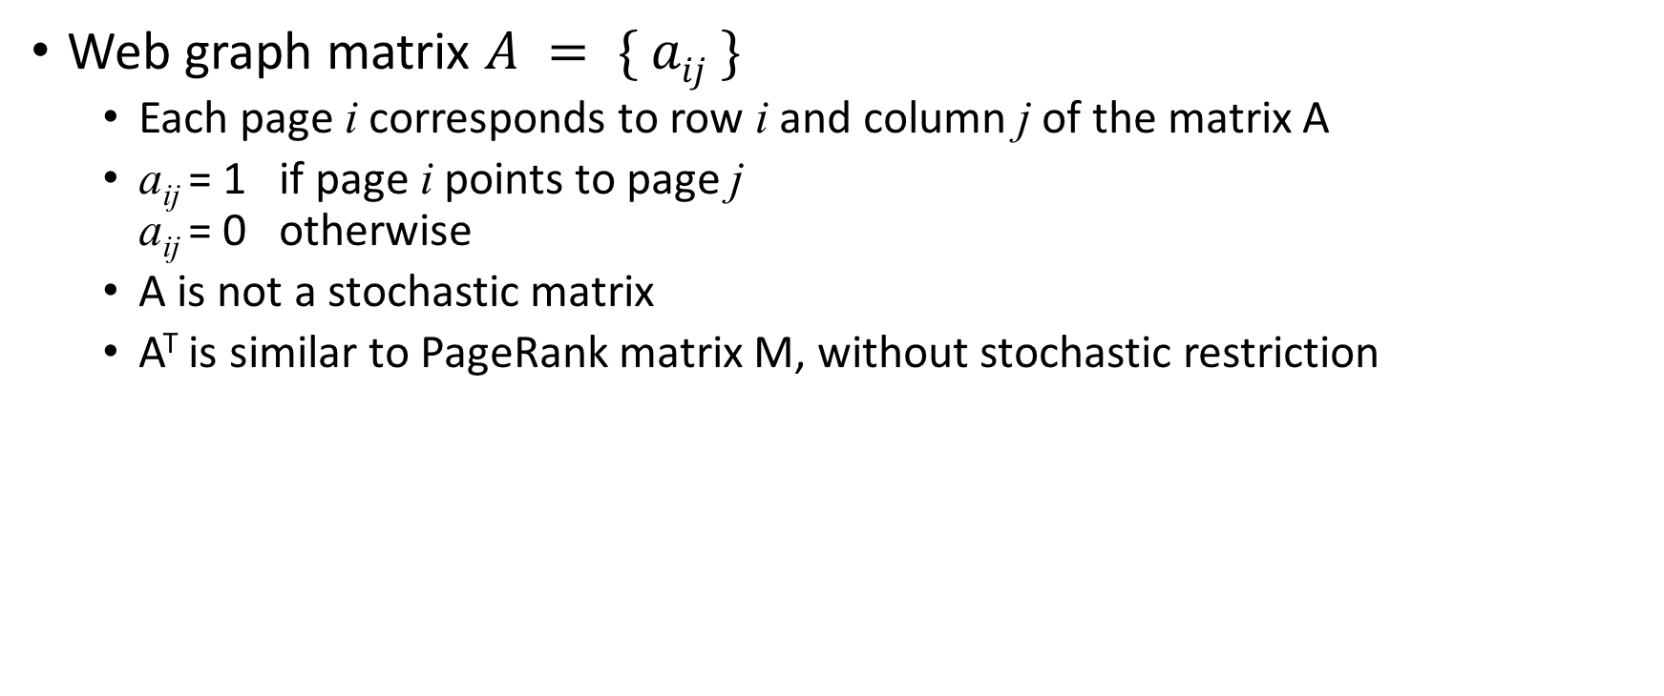
Hub and Authority: Matrix Notation
Web graph matrix $A = \{ aij \}$
  Each page i corresponds to row i and column j of the matrix A
  a_{ij} = 1 if page i points to page j
  a_{ij} = 0 otherwise
  A is not a stochastic matrix
  A^{T} is similar to PageRank matrix M, without stochastic restriction

Slide 5
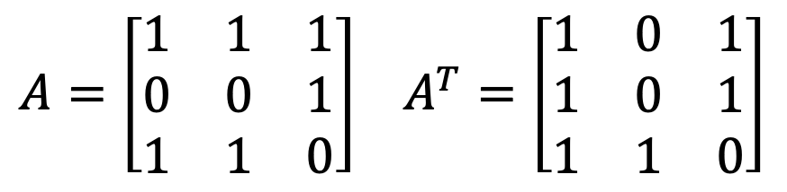
Example
Nf
$A=\left[\begin{matrix}1 & 1 & 1 \\ 0 & 0 & 1 \\ 1 & 1 & 0\end{matrix}\right]$ $A^{T}=\left[\begin{matrix}1 & 0 & 1 \\ 1 & 0 & 1 \\ 1 & 1 & 0\end{matrix}\right]$
MS
Am

Slide 6
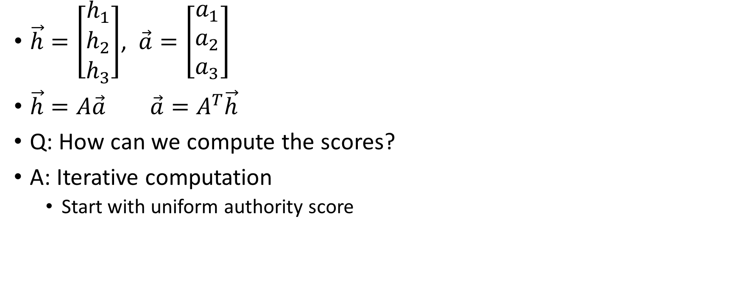
Hub/Authority: Matrix Notation
$\vec{h}=\left[\begin{matrix}h_{1} \\ h_{2} \\ h_{3}\end{matrix}\right]$, $\vec{a}=\left[\begin{matrix}a_{1} \\ a_{2} \\ a_{3}\end{matrix}\right]$
$\vec{h}=A\vec{a} \vec{a}=A^{T}\vec{h}$
Q: How can we compute the scores?
A: Iterative computation
  Start with uniform authority score

Slide 7
Hub and Authority: Iterative Computation
Start with the same authority score for all pages
Compute the hub scores from the authority scores using the equations
Compute the authority scores from the hub scores using the equations
Repeat until convergence

Slide 8
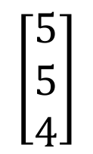
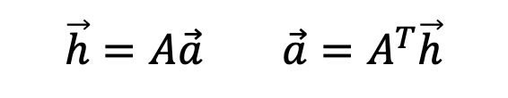
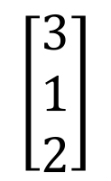
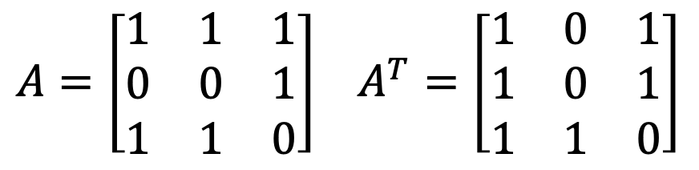
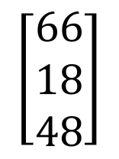
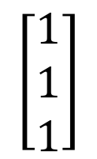
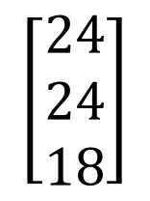
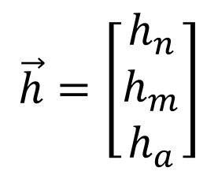
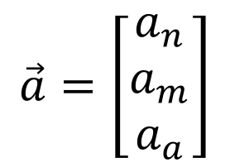
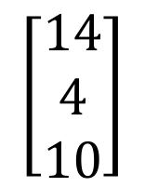
Example: Iterative Computation
Nf
$A=\left[\begin{matrix}1 & 1 & 1 \\ 0 & 0 & 1 \\ 1 & 1 & 0\end{matrix}\right]$ $A^{T}=\left[\begin{matrix}1 & 0 & 1 \\ 1 & 0 & 1 \\ 1 & 1 & 0\end{matrix}\right]$
$$\vec{h}=A\vec{a} \vec{a}=A^{T}\vec{h}$$
MS
Am
$$\vec{a}=\left[\begin{matrix}a_{n} \\ a_{m} \\ a_{a}\end{matrix}\right]$$
$$\left[\begin{matrix}1 \\ 1 \\ 1\end{matrix}\right]$$
$$\left[\begin{matrix}5 \\ 5 \\ 4\end{matrix}\right]$$
$$\left[\begin{matrix}24 \\ 24 \\ 18\end{matrix}\right]$$
Q: Any problem?
Q: How can we avoid divergence?
$$\vec{h}=\left[\begin{matrix}h_{n} \\ h_{m} \\ h_{a}\end{matrix}\right]$$
$$\left[\begin{matrix}3 \\ 1 \\ 2\end{matrix}\right]$$
$$\left[\begin{matrix}14 \\ 4 \\ 10\end{matrix}\right]$$
$$\left[\begin{matrix}66 \\ 18 \\ 48\end{matrix}\right]$$

Slide 9

Hub and Authority: Iterative Computation
Normalization
  Hub and Authority graph matrix is not a stochastic matrix
  To prevent divergence, normalize the vector to the same fixed size
  $\vec{h}=λ A\vec{a}$ $λ$: normalization factor
  $\vec{a}={μ A}^{T}\vec{h} μ\text{: }\text{normalization} \text{factor}$

Slide 10
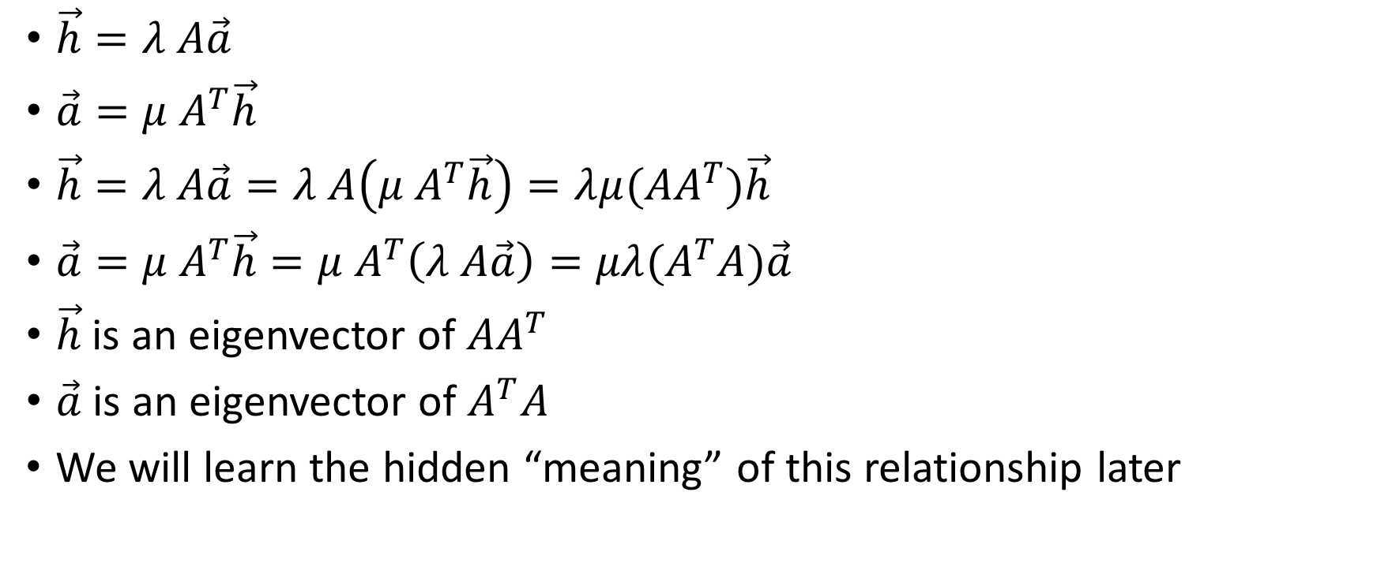
Hub and Authority: Eigenvector
$\vec{h}=λ A\vec{a}$
$\vec{a}={μ A}^{T}\vec{h}$
$\vec{h}=λ A\vec{a}=λ A\left({μ A}^{T}\vec{h}\right)=λ{μ(AA}^{T})\vec{h}$
$\vec{a}={{μ A}^{T}\vec{h}=μ A}^{T}\left(λ A\vec{a}\right)={μλ(A}^{T}A)\vec{a}$
$\vec{h}$ is an eigenvector of ${AA}^{T}$
$\vec{a}$ is an eigenvector of $A^{T}A$
We will learn the hidden “meaning” of this relationship later

Slide 11
Hub and Authority: Root Set
Apply the equations on a neighbor of “base set”
  Start with, say, 100 pages on “bicycling”
  Add pages pointing to the 100 pages
  Add pages that the 100 pages are pointing to
Identified pages are good “Hub” and “Authority” on “bicycling”

Slide 12
Hub and Authority: Community Detection
Hub/Authority is often used to identify Web communities
  Nice notion of “Hub” and “Authority” of the community
  Often Hub and Authority are tightly linked to each other

Slide 13
Questions
PageRank is applied to the entire Web graph
Hub and Authority is applied to a small community graph
Q: Can we apply Hub/Authority to the entire Web like PageRank?

Slide 14
Hub and Authority on the Entire Web?
Hub/Authority works well on a topic-specific subset, but works poorly for the whole Web
Easy to spam
  Create a page pointing to many authority pages
  (e.g., NY Times, Wikipedia, Google, etc.)
  → The page becomes a good hub page
  On the page, add a link to your home page

Slide 15
Using Anchor Text
Anchor text: Clickable text on a link
Example: I am a student at UCLA
Anchor text is often an excellent summary of the linked page
  Better match than the content of the page!
  Q: Can we use this observation to improve ranking?

Slide 16
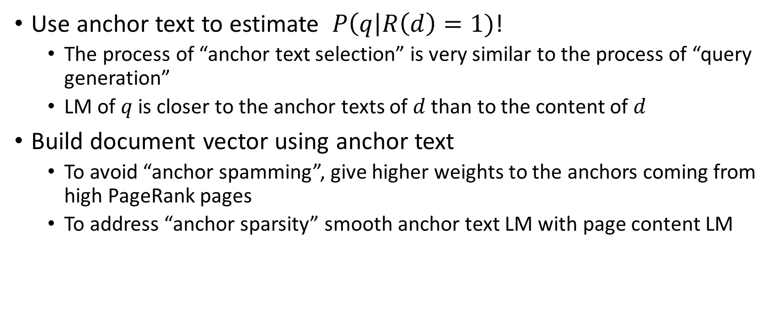
Using Anchor Text
Use anchor text to estimate $P\left(q\right|R\left(d\right)=1)$!
  The process of “anchor text selection” is very similar to the process of “query generation”
  LM of $q$ is closer to the anchor texts of $d$than to the content of $d$
Build document vector using anchor text
  To avoid “anchor spamming”, give higher weights to the anchors coming from high PageRank pages
  To address “anchor sparsity” smooth anchor text LM with page content LM

Slide 17
Second-Generation Search Engines
First-generation search engines were purely based on traditional IR
Second-generation engines got a “quantum jump” in ranking quality from
  Improved query language model from anchor text
  Improve document popularity model from PageRank and click data

Slide 18
References
[Kleinberg 1999] Jon Kleinberg: Authoritative sources in a hyperlinked environment, Journal of ACM 1999

